Slide 1
PEIMS Discipline
Federal and State Compliance
Latonya Smith, Sr. Compliance Analyst
Wanda Thomas, Sr. Manager
Friday, November 18, 2022
2022-2023

Slide 2
Virtual Meeting Norms
Please mute your microphone and camera.
Place your questions in the chat.
Do not record the session.

Slide 3
PEIMS Discipline Agenda
FERPA
Campus Roles/Responsibilities
PEIMS Discipline FATALS
Reporting Requirements
Discipline Entry
HISD Connect Reports
Summer PEIMS Reports
Manual Records / Review
On-Data Suite (ODS)
Records Retention
Resources
FSC Contacts
Questions

Slide 4
PEIMS Coding
In no case should paraprofessional personnel be responsible for determining students coding

Slide 5
FERPA

Slide 6
Family Educational Rights and Privacy Act (FERPA)
The Family Educational Rights and Privacy Act (FERPA) (20 U.S.C. § 1232g; 34 CFR Part 99) is a Federal law that protects the privacy of student education records. The law applies to all schools that receive funds under an applicable program of the U.S. Department of Education.
Generally, schools must have written permission from the parent or eligible student in order to release any information from a student's education record. However, FERPA allows schools to disclose those records, without consent, to the following parties or under the following conditions (34 CFR § 99.31):
School officials with legitimate educational
interest;
Other schools to which a student is transferring;
Specified officials for audit or evaluation purposes;
Appropriate parties in connection with financial aid to a student;
Organizations conducting certain studies for or on behalf of the school;
Accrediting organizations;
To comply with a judicial order or lawfully issued subpoena;
Appropriate officials in cases of health and
safety emergencies; and
State and local authorities, within a juvenile justice system, pursuant to specific State law.
6

Slide 7
Campus Roles and Responsibilities

Slide 8
Campus Behavior Coordinator
Under the requirements of Senate Bill 107, 84th legislature, TEC 37.0012, each campus must have a staff person designated as the Campus Behavior Coordinator. The person designated may be the principal of the campus or any other campus administrator selected by the principal.
The campus behavior coordinator is primarily responsible for maintaining student discipline and the implementation of this subchapter.
The campus behavior coordinator is required to promptly notify a student's parent or guardian if the student is placed into in-school or out-of-school suspension, placed in a disciplinary alternative education program, expelled, or placed in a juvenile justice alternative education program or is taken into custody by a law enforcement officer. A campus behavior coordinator must comply with this subsection by: (1) promptly contacting the parent or guardian by telephone or in person; and (2) making a good faith effort to provide written notice of the disciplinary action to the student, on the day the action is taken, for delivery to the student's parent or guardian.
If a parent or guardian entitled to notice of a student’s disciplinary removal has not been reached by telephone or in person by 5 p.m. of the first business day after the day the disciplinary action is taken, the campus behavior coordinator must mail written notice of the disciplinary action to the parent or guardian at the parent's or guardian's last known address. If a Campus Behavior Coordinator is unable or not available to promptly provide the required notice to a parent or guardian of a student, the principal or other designee shall provide the notice.

Slide 9
PEIMS Coordinator
Responsibilities:
Attend scheduled trainings and meetings related to PEIMS program areas. Consult with the Federal State and Compliance Analyst to schedule appropriate training for campus personnel.
Collaborate with the principal to designate campus contacts for each data type that impacts, funding, compliance, and accreditation as well as contacts who are responsible for special program content knowledge.
Identify, document and supply data reporting timelines and procedures to all personnel affected by them.
Keep principal informed as to the accountability and accuracy of all
PEIMS data.
Oversee the reasonableness and accuracy of data by implementing procedures at the campus to ensure the data that affects funding, compliance, or accreditation is complete and correct by identifying areas of concern and determining corrective action.
Work cooperatively with other campus personnel to collect, organize, and format data required for submitting campus PEIMS information in a timely manner.
51

Slide 10
iDelegate/Data Responsibilities Contacts
Campuses must keep this form updated so that FSC can contact the appropriate staff regarding training, data errors, compliance reviews and TEA data reviews.
Clerical staff should not be designated where Certified Professionals are required.
54

Slide 11
Enter discipline from the First Day of School through the Last Day of School.
Enter discipline as soon as it occurs.
Notes:
Joe:
Please refer to the important timelines on the chart below.
Important Timelines
Last Day, Last School Year (SY) 6/8/2012
School Start Window 8/27 – 9/28/2012
Snapshot (no relation to leavers) 10/26/2012
Edit+ Presumed Under-Reported Students list (Students who were reported during the 2001-2012, but not reported anywhere during current school start window)
December 2012
Student Searches Should be Complete 1/10/2013
Resubmission Early January 2013
TEA Publishes Dropout Completion Lists Mid June 2013
Appeals Deadline Mid August 2013
Ratings Update Late October 2013
(Advance to the next screen)

Slide 12
PEIMS Discipline FATALS

Slide 13
TSDS Student Discipline
44425 – Discipline Incident
Description
A Discipline Incident represents an occurrence of an infraction ranging from a minor problem behavior that disrupts the orderly functioning of a school or classroom (such as tardiness) to a criminal act that results in the involvement of a law enforcement official (such as robbery). A single event (e.g., a fight) is one incident regardless of how many perpetrators or victims are involved. Discipline incidents are events classified as warranting discipline action.

Slide 14
TSDS Student Discipline
A PEIMS 425 record is required for each disciplinary action taken against any student which results in the removal from his/her Instructional setting.
Multiple violations are sometimes committed in the course of one disciplinary event. The appropriate code to use in this event is the offense code representing the most serious violation. DO NOT make multiple entries in the Discipline Reason Code field.
Multiple consequences are frequently administered for a single offense. A PEIMS 44425 record must be recorded for each disciplinary action that results in a removal.
44425 records are reported at the end of the current school year and are a part of PEIMS Submission 3.

Slide 15
Reporting Requirements

Slide 16
Texas Education Code (TEC) 37.008(m-1)
Under TEC 37.008(m-1), failure to report all disciplinary removals as required by state and federal law may result in a review by the commissioner of education and notice to the local school board of any problems noted in the district’s data, or a violation of a law or other rule.
This review may also result in a notification to the county attorney, district attorney, criminal district attorney, as appropriate, and the attorney general. This provision can apply to missing, inaccurate, and/or falsified information/data.

Slide 17
For purposes of discipline data reported to TEA, the attendance/PEIMS data personnel are only responsible for entering information that has been provided to them by the Superintendent or their designee(s) who are responsible for applying the Student Code of Conduct to student behavior. In no case should attendance/PEIMS data personnel be responsible for determining a student's coding information for discipline actions taken.

Slide 18
Removal Categories
Every disciplinary action that results in the removal of a student from any part of their regular academic program will be categorized in one of the following general categories:
Suspensions ( in & out of school )
DAEP assignments
Expulsions to the Juvenile Justice Alternative Education Program
DAEP & JJAEP Continuations
HB 2619 requires school districts to provide notice to a foster child’s educational decision-maker and caseworker regarding certain events that may significantly impact the child’s education.

Slide 19
HB 674 Out-of-School Suspensions for students below grade level three
HB 674, passed during the 85th Legislative session (2017), amends Texas Education Code TEC 37.005 to limit the conditions under which a student below grade three may be placed in an out-of-school suspension (OSS).

Slide 20
HB 674 Out-of-School Suspensions for students below grade level three
A student who is enrolled in a grade level below grade three may not be placed in out-of-school suspension unless, while on school property or while attending a school-sponsored or school-related activity on or off of school property, the student engages in:
Conduct that contains the elements of an offense related to weapons under Section 46.02 or 46.05 Penal Code;
Conduct that contains the elements of a violent offense under Section 22.01, 22.011, 22.02, or 22.021 Penal Code;
Selling, giving, or delivering to another person or possessing, using, or being under the influence of any amount of:
Marihuana or controlled substance,
A dangerous drug, or
An alcoholic beverage.

Slide 21
HB 674 Out-of-School Suspensions for students below grade level three
IF a student is below grade three and they are assigned Out-Of-School Suspension DISCIPLINARY-ACTION-CODE 05 or Partial Day Out-Of-School Suspension DISCIPLINARY-ACTION-CODE 25 then the reason DISCIPLINARY-ACTION-REASON-CODE for the assignment must be one of the following:
04 - Possessed, Sold, Used, Or Was Under The Influence Of Marihuana
05 - Possessed, Sold, Used, Or Was Under The Influence Of An Alcoholic
11 – Brought a Firearm to School
12 – Unlawful Carrying of a Location-Restricted Knife (Location-Restricted Knife - blade longer than 5.5 inches)
13 – Unlawful Carrying of a Club
14 –Conduct Containing the Elements of an Offense Relating to Prohibited Weapons
27 - Assault Against a school district employee or volunteer
28 – Assault Against someone other than a school district employee or volunteer
29- Aggravated Assault Against a school district employee or volunteer
30 – Aggravated Assault Against someone other than a school district employee or volunteer
31 – Sexual Assault Or Aggravated Sexual Assault Against a school district employee or volunteer
32 - Sexual Assault Or Aggravated Sexual Assault Against someone other than a school district employee or volunteer

Slide 22
HB 692 – RELATED TO SUSPENSIONS FOR STUDENTS WHO ARE HOMELESS
Background:
Under HB 692, suspensions for homeless students are addressed.
A student who is homeless cannot be placed in out of school suspension unless the student engages in conduct described in TEC 37.005(c) 1-3. TEC 37

Slide 23
HB 692
AN ACT relating to the suspension of a student who is homeless from public school.
BE IT ENACTED BY THE LEGISLATURE OF THE STATE OF TEXAS:
SECTION 1. Section 37.005, Education Code, is amended by adding Subsection (d) to read as follows:
(d) A school district or open-enrollment charter school may not place a student who is homeless in out-of-school suspension unless the student engages in conduct described by Subsections (c)(1)-(3) while on school property or while attending a school-sponsored or school-related activity on or off of school property. The campus behavior coordinator may coordinate with the school district's homeless education liaison to identify appropriate alternatives to out-of-school suspension for a student who is homeless. In this subsection, "student who is homeless" has the meaning assigned to the term "homeless children and youths“ under 42 U.S.C. Section 11434a.

Slide 24
HB 692 Business Rules
If this student’s HOMELESS-STATUS-CODE is not “0”, and DISCIPLINARY-ACTION-CODE is "05" or "25", then DISCIPLINARY-ACTION-REASON-CODE should be "04", "05", "11", "12", "13", "14", "27", "28", "29", "30", "31", or "32“
04 - Possessed, Sold, Used, Or Was Under The Influence Of Marihuana
05 - Possessed, Sold, Used, Or Was Under The Influence Of An Alcoholic
11 – Brought a Firearm to School
12 – Unlawful Carrying of a Location-Restricted Knife (Location-Restricted Knife - blade longer than 5.5 inches)
13 – Unlawful Carrying of a Club
14 –Conduct Containing the Elements of an Offense Relating to Prohibited Weapons
27 - Assault Against a school district employee or volunteer
28 – Assault Against someone other than a school district employee or volunteer
29- Aggravated Assault Against a school district employee or volunteer
30 – Aggravated Assault Against someone other than a school district employee or volunteer
31 – Sexual Assault Or Aggravated Sexual Assault Against a school district employee or volunteer
32 - Sexual Assault Or Aggravated Sexual Assault Against someone other than a school district employee or volunteer

Slide 25
SB 2432 Harassment against an employee of the school district
Under SB 2432 , TEC section 37.006(a) is expanded to allow the removal of a public school student from the classroom following engaging in conduct that contains elements of the offense of harassment under Section 42.07(a)(1), (2), (3), or (7) Penal Code, against an employee of the school district.

Slide 26
SB 2432
AN ACT relating to the removal of a public school student from the classroom following certain conduct.
BE IT ENACTED BY THE LEGISLATURE OF THE STATE OF TEXAS:
SECTION 1. Section 37.006(a), Education Code, is amended to read as follows:
(a) A student shall be removed from class and placed in a disciplinary alternative education program as provided by Section 37.008 if the student:
…
(2) commits the following on or within 300 feet of school property, as measured from any point on the school's real property boundary line, or while attending a school-sponsored or school-related activity on or off of school property:
…
(G) engages in conduct that contains the elements of the offense of harassment under Section 42.07(a)(1), (2), (3), or (7), Penal Code, against an employee of the school district.

Slide 27
SB 179 Bullying Behaviors
Under SB 179 (85th), TEC section 37.0052 was added to allow a public school to expel a student from the classroom for certain bullying behaviors.
The offense of bullying under TEC 37.0052, which addresses the expulsion of students for certain bullying behaviors allows for either a discretionary removal to DAEP or an expulsion.

Slide 28
SB 179
SECTION 3. Subchapter A, Chapter 37, Education Code, is amended by adding Section 37.0052 to read as follows:
Sec. 37.0052. PLACEMENT OR EXPULSION OF STUDENTS WHO HAVE ENGAGED IN CERTAIN BULLYING BEHAVIOR.
(a) In this section:
(1) "Bullying" has the meaning assigned by Section 37.0832.
(2) "Intimate visual material" has the meaning assigned by Section 98B.001, Civil Practice and Remedies Code.
(b) A student may be removed from class and placed in a disciplinary alternative education program as provided by Section 37.008 or expelled if the student:
(1) engages in bullying that encourages a student to commit or attempt to commit suicide;
(2) incites violence against a student through group bullying; or
(3) releases or threatens to release intimate visual material of a minor or a student who is 18 years of age or older without the student's consent.
(c) Nothing in this section exempts a school from reporting a finding of intimate visual material of a minor.

Slide 29
Reason Codes for Bullying and Harassment
Two new disciplinary action reason codes are added

Slide 30
Removal of Students who Receive Special Education and Related Services
For disciplinary removals of a student who is receiving special education and related services from the student's current educational placement, a change of placement occurs if the removal is for more than 10 consecutive days (CFR §300.530 - §300.536).
The ARD committee that deals with the change of placement must review the student's IEP to detail the special education and related services to be administered to the student while he is removed for discipline reasons.
Be careful not to confuse the 10-day change of placement requirement for special education purposes with the 1-day removal requirement for 425 record reporting purposes.

Slide 31
Removal of Students who Receive Special Education and Related Services
A 425 record is required for all students who are receiving special education and related services and are removed from their regularly scheduled classes for one day or more.
A change of placement occurs when the removal is for more than 10 consecutive days, and a change of placement may occur when the removal is for more than 10 cumulative days in a school year based on factors such as the length of each removal, the total amount of the time the child is removed, and the proximity of the removals to one another.
An ARD committee must be involved when the removal or series of removals constitute a change in placement.

Slide 32
PEIMS vs HISD Connect
TSDS PEIMS | HISD Connect
Disciplinary Action Reason Code | Behavior Code
Disciplinary Action Code | Action Code
Actual Days Assigned | Assigned Duration
Actual Days Served | Actual Duration
Difference Code | Duration Code
Behavior Location Code Date of Disciplinary Action | Location Action Begin Date

Slide 33
Disciplinary Reason Codes
LOCAL Reason Codes
CLET – excessive talking/yelling
CLRP – refusal to participate/work
CMDP – destruction of property
CLRB – derogatory/abusive language(to staff)
CMSA – violation of safety rules
SBDL – abusive language/gestures on school bus
CMRD – failure to comply with reasonable directive
CMDP – destruction of property
PEIMS Reason Codes
02 – Conduct punishable as a felony
*04 – Possessed, sold, used, or was under the influence of marihuana or other controlled substance
*05 – Possessed, sold, used, or was under the influence of an alcoholic beverage
11 – Used, exhibited, or possessed a firearm
*21 – Violation of student code of conduct
26 – Terroristic threat
41 – Fighting/Mutual Combat (Must involve 2 or more students from the same campus)
The Offenses-Consequences Charts have a complete list of disciplinary codes. *Review the Student Discipline Reason/Event Code 21 and 04, 05 – Discipline Behaviors/Violations chart for the expanded list of codes.

Slide 34
Disciplinary Action Codes
LOCAL ACTION CODES
ASCO – Adm Stu or Parent Conf
ASPC – Adm/Stu/Parent Conf
BUSP – Removal of Bus Privilege
CALL – Parent Contact by phone
DENT – Detention
PCON –Parent/Guardian Contact
EXCL –Excl from exc activities
PEIMS ACTION CODES
05 – SUSP Out of School Suspension
06 – STIS In School Susp
07 – ALTR Placement in DAEP
02 – EJJA Expulsion to JJAEP
08 – COAE Cont. of DAEP Placement from another school district
15 – COEO Continuation of another school district’s JJAEP Placement
06 – STIS In School Susp

Slide 35
Mandatory Removal to DAEP (07)
02 – Felony (school related)
*04 – Possession, selling, or under the influence of a controlled substance- DAEP or JJAEP
*05 – Possession, selling, or under the influence of alcohol - DAEP or JJAEP
06 – Abuse of a volatile chemical – DAEP or JJAEP
07 – Public lewdness – DAEP
09 – Felony Offenses in Title 5 - DAEP
08 – Retaliation against district employee – DAEP or JJAEP
22 – Criminal mischief – DAEP or JJAEP
26 – Terroristic threat – DAEP or JJAEP
27 – Assault against employee – DAEP or JJAEP (with bodily injury)
28 – Assault against non-employee – DAEP (with bodily injury) (Victim Letter required)
35 – False alarm, false report – DAEP
55 – Required to register as a sex offender – DAEP
60 – Harassment Against an Employee of the school district.
The Offenses-Consequences Charts have a complete list of disciplinary action reason codes. *Review the Student Discipline Reason/Event Code 21 and 04, 05 – Discipline Behaviors/Violations chart for the expanded list of codes.

Slide 36
Mandatory Expulsion to JJAEP (02) Danger Campus Indicators (CAMPUS-RELATED)
11 – Brought a Firearm to School – Unlawful carrying of a Handgun
12 – Unlawful Carrying of a location restricted knife.
13 – Unlawful Carrying of a Club
14 – Conduct Containing the Elements of an Offense relating to Prohibited Weapons
16 – Arson
17 – Murder
18 – Indecency with a child (Victim Letter required)
19 – Aggravated kidnapping (Victim Letter required)
29 – Aggravated assault against employee
30 – Aggravated assault against non-employee (Victim Letter required)
31 – Sexual assault against employee
32 – Sexual assault against non-employee (Victim Letter required)
36 – Drug-related felony
37 – Alcohol-related felony
46 – Aggravated robbery
47 - Manslaughter
48 – Criminally negligent homicide
57 – Continuous sexual abuse of a young child (Victim Letter required)

Slide 37
Discretionary Coding to DAEP or JJAEP
01- Permanent removal by a teacher from class – (Discretionary Placement)
10 - Non-Title 5 Felony Committed Off Campus – (Discretionary placement or expulsion)
21 - Violation of Student Code of Conduct – (Discretionary placement)
23 - Emergency Placement/Expulsion – (Discretionary placement or expulsion)
41 - Fighting/Mutual Combat – (Discretionary placement)
49 - Deadly Conduct – (Discretionary placement or expulsion)
56 - Student Is Required to Register as A Sex Offender Under Chapter 62 Of The Code Of Criminal Procedure And Is Not Under Court Supervision – (Discretionary placement)
58 - Breach of Computer Security Under Penal Code §33.02 – TEC 37.007 – (Discretionary expulsion)
59 - Serious Misbehavior, as defined by TEC §37.007(c), while expelled to/placed in a Disciplinary Alternative Education Program (DAEP) – (Discretionary Expulsion)
61 - Bullying – TEC 37.0052(b) – (Discretionary placement or expulsion)

Slide 38
Discipline Entry
Reporting Discipline in HISD Connect
This is a brief overview on reporting student discipline information in HISD Connect.

Slide 39
DO NOT USE CODES
Reason Code 21
Use only the breakdown of 21’s
Reason Code 04
Use ONLY PS04, IN04, DI04
Reason Code 05
Use ONLY PS05, IN05, DI05

Slide 40
HISD Connect
First, enter a discipline incident record by going to Incident Management page.
The SMS automatically assigns an incident number to the incident record. This incident number CAN NOT BE EDITED.
By creating the incident record first and then adding the students involved, you will ensure that all persons involved and all actions taken will have the same incident number as required by PEIMS.
NOTE: Any other path may result in different incident numbers for parts of the same incident and will result in PEIMS errors.

Slide 41
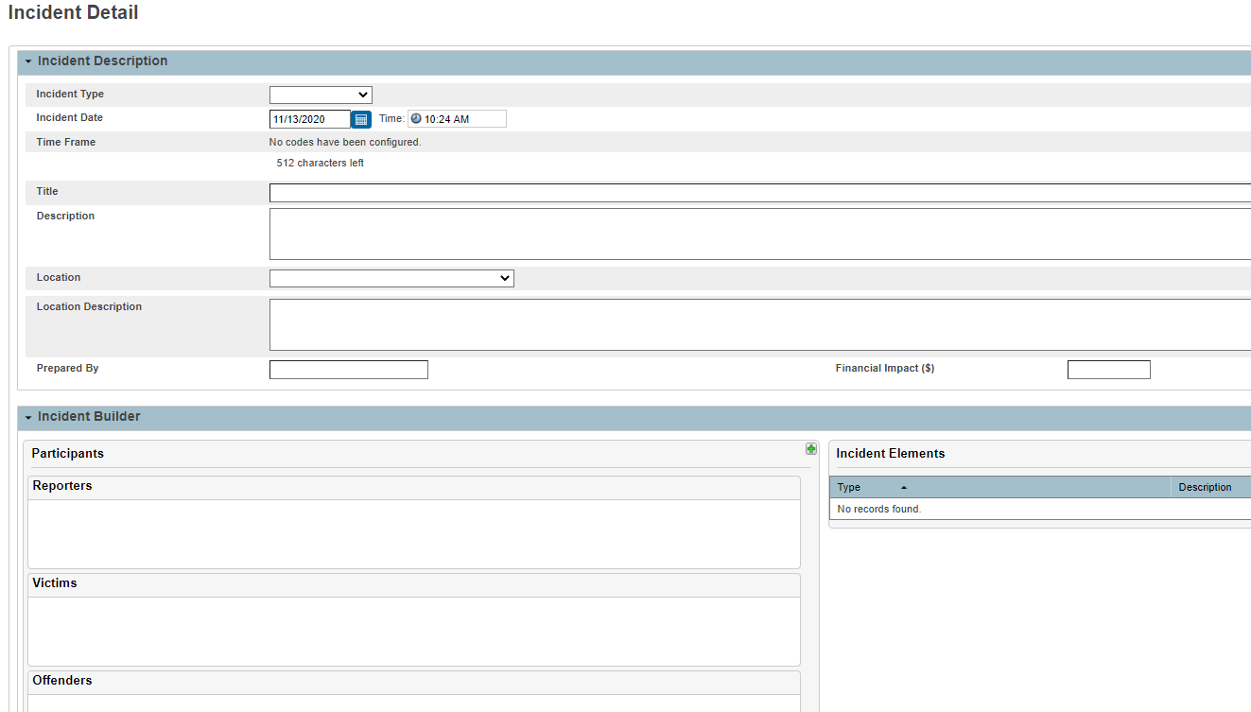
HISD Connect

Slide 42
Behavior Location Code
Behavior Location Code indicates where a student committed an applicable offense that is enumerated in Texas Education Code 37.006 or 37.007. (On/off campus, school related activities, etc…).
C190 code added (Behavior Location Codes)
00 - Not Applicable
01 - On Campus
02 - Off Campus, but within 300 feet of campus property line
03 - Off Campus, but at a school sponsored or school related activity
04 - Off Campus, and further than 300 feet from the campus boundary (Student was not in attendance at a school sponsored or school related activity)
05 - On campus of another school district, or while in attendance at a school sponsored or school related activity of another school district

Slide 43
Action Date Range
Action Date Range is the date that the disciplinary assignment was ordered. This date may or may not:
Differ from the disciplinary infraction date.
Reflect the date on which the disciplinary assignment begins. For continuation assignments, this date reflects the first day of the continuation.
The date must be PRIOR to the student’s withdrawal from school. A date equal to or later than the withdrawal date will result in a PEIMS error.
The date must be within the school calendar year and it MUST be entered for all PEIMS actions: 05, 06, 07, 08, etc.
HISD Connect - Action Date Range

Slide 44
Other Fields

Slide 45
Correct Entry
Student Name

Slide 46
Incorrect Entry

Slide 47
HISD Connect Reports
Data Verification and Supporting Reports
Incident Management Discipline Interchange Validation Report
Incident Management Verification Report
Student Incident Profile Report

Slide 48
Incident Management Discipline Interchange Validation Report

Slide 49
Incident Management Verification Report

Slide 50
Student Incident Profile Report

Slide 51
Summer PEIMS Reports
Student Disciplinary Action Summary
Campus ID of Accountability Roster

Slide 52
Student Disciplinary Action Summary

Slide 53
CampusID of Accountability Roster

Slide 54
Manual Records / Reviews
Participants will learn how to:
Access the resources available to help schools accurately document student disciplinary events and actions
Prepare for Federal and State Compliance reviews and/or Texas Education Agency audits
Notes:
Joe:
Lesson 3: Explanation of Leaver Codes
In this lesson, you will learn the expanded definitions of PEIMS Leaver codes. In addition, you will learn more about the HISD local mover codes.
(Advance to the next screen)

Slide 55
Compliance Review Process
Review Reports
Discipline review file is generated in FSC
Schedule Visit
Email campus behavior coordinator
Provide records for review
Provide area to review records
Conduct Review
Check records according to guidelines
Document findings
Share Findings
Discuss findings of the review
Sign, date and provide campus behavior coordinator or principal designee a copy of report

Slide 56
Discipline Referral Form
Required for every student that is removed from their instructional setting
Fulfills all TEA PEIMS requirements
Used for HISD compliance review purposes and should be the cover page for all disciplinary actions
Requirements for All referral forms
Demographic Information
Reason for referral
PowerSchool incident number
PEIMS reason / PEIMS action
Days and dates assigned
Administrators signature BLUE OR BLACK INK
No signature stamps
No correction tape or correction fluid
Houston Independent School District
Campus Name:
Discipline Referral
Form
Date of Referral:
Student ID:
Name:
Grade:
Gender:
Referred by:
Location of Infraction:
Incident
___________
Incident
_______________
Room
_____________
Phone:
_________________________
Date:
Time:
_
No.:
Problem Behavior (i.e.
,
Replacement Behavior
Interventions (i.e., Actions taken)
Reinforcement
unwanted behavior)
(I.e., desired behavior)
Reason for Referral
Date
* * * * * * * * * * * * * * * * * * * * * * * * *
* For Administrative Use Only
* * * * * * * * * * * * * * * * * * * * * * * * * *
CHANCERY INCIDENT NU
MBER:
S
everity Level
:
Level 1
Level 2
Level 3
Level 4
Level 5
Local Reason (Offense) Code
:
Local Action (Consequence) Code
(s)
:
Select the
Category of Incident
for Bullying Allegations:
Disability
Race/Color/ National Origin
Religion
Sex
Sexual Orientation
Other:_________
__
PEIMS REASON (OFFENS
E) CODE:
__________
PEIMS ACTION (CONS
EQUENCE) CODE(S):
______
____
Infraction
01(On Campus)
04 (
Off Campus, not school related/ sponsored activity)
Location
02 (Off Campus, within 300 ft)
05 (
On school property, or at school related/sponsored activity, of another
Codes
03 (
School Related/ Sponsored
school district)
PEIMS Action
s
Activity Off Campus)
(Consequence
s
)
Details:
Date Action
Begin Date
End Date
Days
Days
Discrepancy
Campus
Campus
In
-
School Suspension (ISS)
Assigned
Assigned
Completed
Reason
Assigned
Responsible
Out
-
of
-
School Suspension
(OSS)
Placement in DAEP
Expulsion to JJAEP
OTHER ACTIONS
:
ARMS/Police Incident Number (if police notified)
________________
__
Victim of Violent Crime Letter
Y
N
NOTE: Use one of the following PEIMS Action Codes when a
Mandatory Action
is not taken:
27 Special Ed.
Student
28 Reason for use of Mandatory Action Not Taken
Date Action Assigned:______________
Date Ac
tion Assigned:________________
Student's age and intent or lack of intent at the time
Potential effect of the misconduct on the school environment
the student engaged in the conduct
The facts of the c
ase warrant consideration of self
-
defense as a mitigating factor in
Student's attitude
the assessment of any punishment
Seri
ousness of the offense
The student has a disability that substantially impairs the student's capacity to
Student's disciplinary history
appreciate the wrongfulness of the student's conduct
Administrator’s Comments:
State law requirements for certain disciplinary
consequences
IMPORTANT NOTE:
The campus discipline coordinator/principal must complete, sign and date the referral form
before
the data is entered
into Chancery. Signature stamps and copies of signatures are invalid. Do not send referrals home that include the names of ot
her students
that were involved in the incident.
Administrator’s Signature
:
Date
:
Student’s
Signature
:
Date:
Parent’s Signature
:
Date:

Slide 57
Discipline Code Change Form
To update reason code or action code
To avoid additional markings on referral
Must be kept in student’s discipline folder
No correction tape or correction fluid
Must sign and date in blue or black INK

Slide 58
In-School Suspension (ISS) Folder Documentation
Discipline Referral Form
Original must remain in discipline folder
In-school parent notification
Addressed to parent
Signed and dated by administrator
Include description of the offense
Include action(s) taken
Include dates and number of days
PEIMS action (06) or (26)
Must not exceed 5 days

Slide 59
Out-of-School Suspension (OSS) Folder Documentation
Discipline Referral Form
Original must remain in discipline folder
Out-of-school parent notification
Addressed to parent
Signed and dated by administrator
Include description of the offense
Include action(s) taken
Include dates and number of days
PEIMS action (05) or (25)
Must not exceed 3 days for each offense

Slide 60
DAEP Folder Documentation
Discipline Referral Form
Original must remain in discipline folder
DAEP Placement notification
Addressed to parent
Signed and dated by administrator
Include description of the offense
Include action(s) taken
Include dates and number of days
DAEP referral
Printed from DAEP system
Receive from administrator
DAEP Email
Email if request is approved, denied, cancelled
Receive from administrator

Slide 61
Juvenile Justice Alternative Education Program (JJAEP)
Discipline Referral Form
Original must remain in discipline folder
Letter of Recommended Expulsion
Addressed to parent
Signed and dated by administrator
Include description of the offense
Include action(s) taken
Include dates and number of days
DAEP Email
Email if request is approved, denied, cancelled
Receive from administrator
For Special Education Students
MDR’s findings and signature page(s)
Receive from Special Ed Chair
Student Victim Letter
Must be on file with appropriate signatures
Include in discipline folder

Slide 62
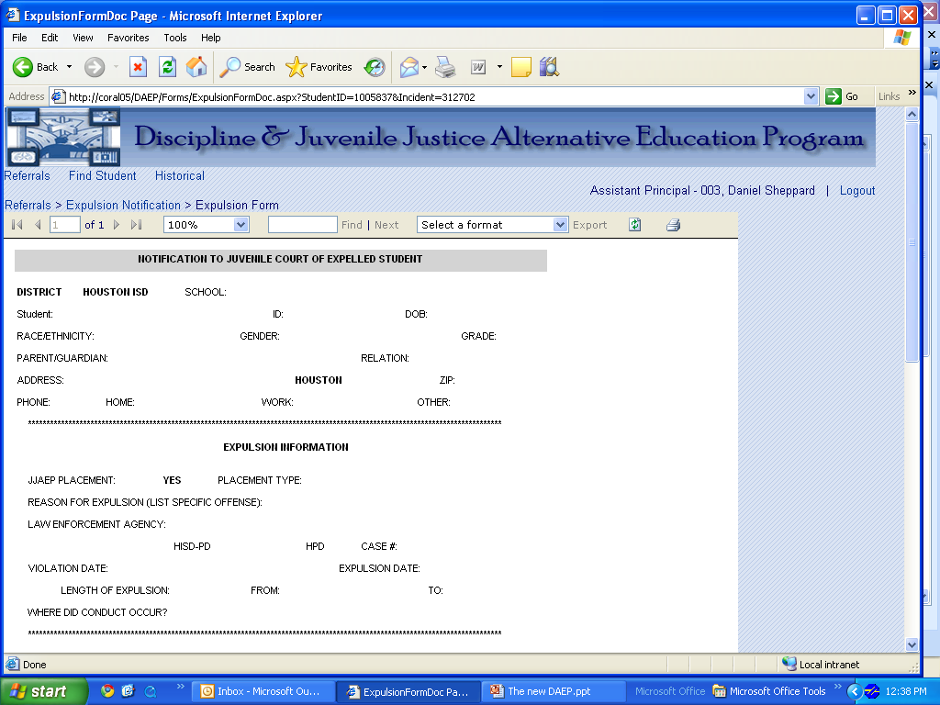
DAEP and JJAEP Referral Example

Slide 63
OnDataSuite
OnDataSuite is currently available to:
Campus PEIMS Coordinators
Campus SIRS
Campus Principals
Campus At-Risk Coordinators
Campus Dean of Instructions

Slide 64
OnDataSuite
View Campus Dashboards by Submission

Slide 65
OnDataSuite
View Data Validation and Custom Reports

Slide 66
OnDataSuite
View Fatals, Warnings and Special Warnings

Slide 67
OnDataSuite
Resources
Training
Register for Online 1456070 in One Source
Tools from OnDataSuite
Manuals
https://manuals.ondatasuite.com/
Training Modules
https://manuals.ondatasuite.com/index.php/training/
Contact Sylvia Guerrero, sylvia.Guerrero@houstonisd.org, if you have questions regarding access to OnDataSuite.

Slide 68
Records Retention
Ensure that campus personnel are aware of storage area
Records should be maintained for at least 5 years
Folders should be in alphabetical order
Label box for current school year
Store in a well-ventilated in case of flood or fire
Records Management contact 713-556-6055

Slide 69
RESOURCES
Appendices and Guides
Bullying Template and Resources
Discipline Charts
Discipline Forms and Templates

Slide 70
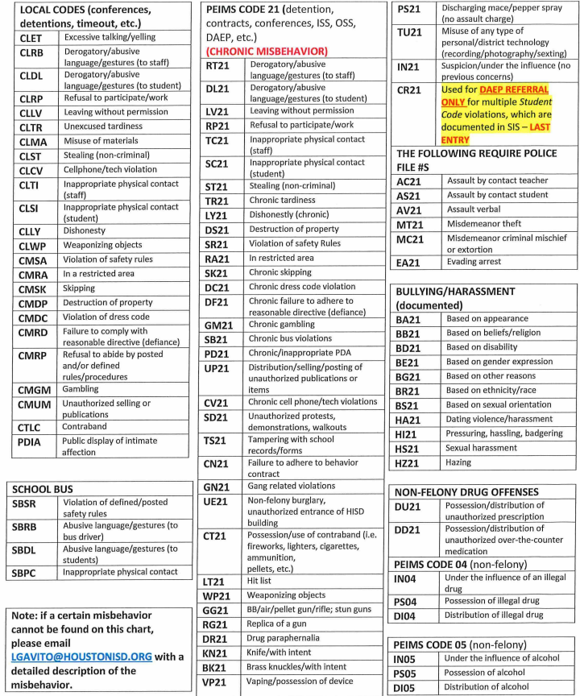
STUDENT DISCIPLINE REASON/EVENT CODE 21 and 04, 05: (DISCIPLINE BEHAVIORS/VIOLATIONS) CHART

Slide 71
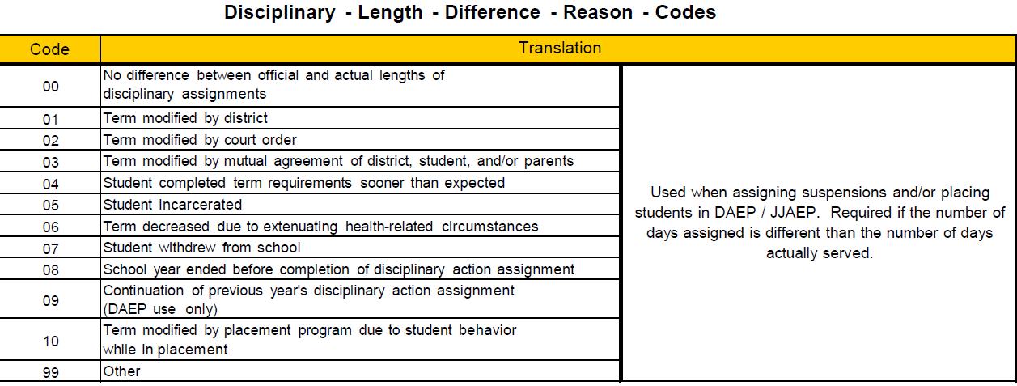
CONSEQUENCES – Expulsion, Difference reason codes

Slide 72
Days Remaining Chart

Slide 73
PEIMS Reason Code Chart

Slide 74
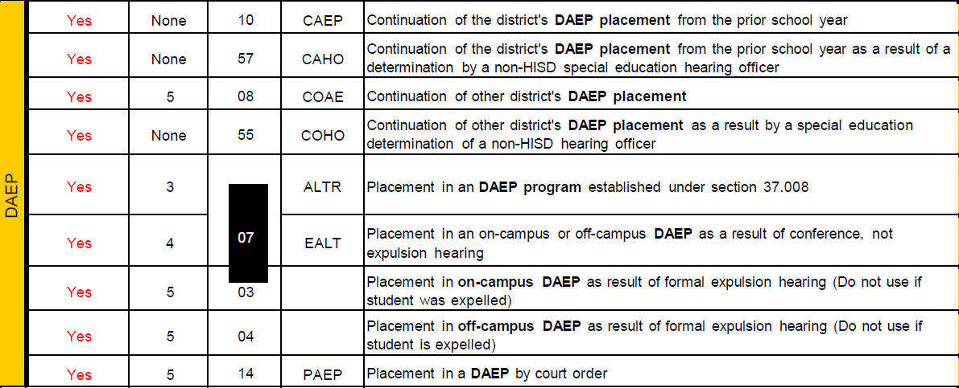
CONSEQUENCES – In-School and Out of School Suspension, DAEP Placements
Yes = Reported to PEIMS

Slide 75
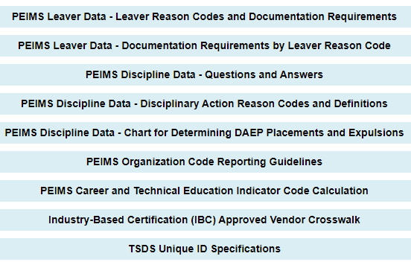
TSDS Web-Enabled Data Standards
2022-2023 Texas Student Data Standards,
https://tealprod.tea.state.tx.us/TWEDS/87/0/0/0/DataSubmission/Technical Resources
Notes:
Go over Appendix E

Slide 76
TSDS Web-Enabled Data Standards

Slide 77
FSC Contacts

Slide 78
Compliance Monitoring Team The Compliance Monitoring Team reviews attendance, discipline and leaver data, collaborates with special populations departments to ensure data integrity, conducts training, and assists the State Reporting Team by overseeing the campus data correction process. In addition, they manage four Sr. Student Information Representatives.
Email | Sr. Compliance Analyst | Sr. Student Information Rep.
Craig.zeno@houstonisd.org | Craig Zeno | Berta Garcia Lisa Shannon Valencia Semien
lsmith3@houstonisd.org | Latonya Smith | Glennedo Hurts Dachundralyn Palmer Alma Salazar
Vacancy | Vacancy | Rachel Betancourt Felicia Freeman Rose Fuentes

Slide 79
State Reporting Team
Name | Phone | Email
Irma Hasnain, Sr. Manager of State Reporting | 713-556-6759 | ihasnain@houstonisd.org
Nancy FigueroaTorres, Sr. Compliance Analyst | 713-556-6767 | nancy.figueroatorres@houstonisd.org
Marina Tejada, Sr. Compliance Analyst | 713-556-6768 | mtejada@houstonisd.org
Vacancy, Sr. Compliance Analyst | 713-556-6760
Sylvia Guerrero, Student Info and Report Analyst | 713-556-6773 | sylvia.guerrero@houstonisd.org
Rose Gamboa, Sr. SIR | 713-556-6771 | rgamboa@houstonisd.org

Slide 80
QUESTIONS?

